Slide 1

Modeling II

Slide 2
Introduction
Instructions
Download Tutorial 11 Zip
Unzip Folder
Required Packages
Open .Rmd File and Knit
Daily Spanish River Data
W = Max Water Temperature
A = Max Air Temperature
L = River Identifier (31 Rivers)
library(tidyverse)
library(modelr)

Slide 3
Introduction
Questions About RMarkdown
What Does the Following Code Do When Knitted?
What Does the following Code Chunk Option Do When Knitted?
`r length(unique(DATA$L))`
echo=F

Slide 4
Introduction
Goal: Build a Model to Predict Max Water Temp Given Max Air Temp
What Do You Know About the Relationship of These Variables?
Who Would Care About this Relationship?
Why Would Someone Want to Predict the Max Water Temp?
Why Would this Model Be Useful?

Slide 5
Introduction
What Do You Know About the Relationship of These Variables?
Who Would Care About this Relationship?
Why Would Someone Want to Predict the Max Water Temp?
Why Would this Model Be Useful?

Slide 6
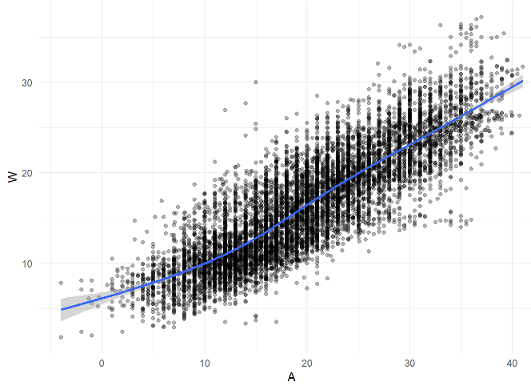
Part 1: Examining the Relationship
Run Chunk 1
What Do You Notice About the Overall Relationship?
Do You Think This Relationship is the Same for All Locations?
Why?
message=F

Slide 7
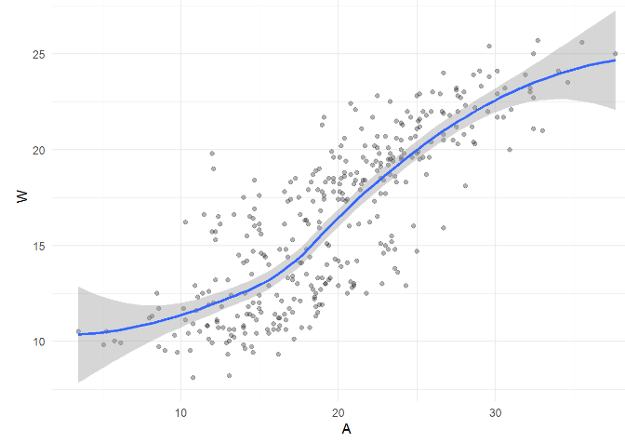
Part 1: Examining the Relationship
Run Chunk 2
Location is a Numeric Variable
What Do You Notice About the Relationship for L==103?
What do You Notice Now?

Slide 8
Part 1: Examining the Relationship
Chunk 2 Modified
Modify Chunk 2 to Create a Function Called WAPlot.func With 1 Argument Location
Function Usage: You Specify the Location as an Integer and the Function Outputs a Figure of the Relationship
Use Your Function For Three Different Locations
Knit the Document to Observe and Compare

Slide 9
Part 1: Examining the Relationship
Chunk 2 Discussion
What are the Differences in the Relationship Between W and A for the Various Locations?
Why do You Think These Differences Exist?
How do You Suggest We Handle the Differences?

Slide 10
Part 1: Examining the Relationship
Chunk 3
Randomly Samples 3 Locations
Plant Your Seed and Run Code
Usage:
anti_join()
semi_join()
Why Don’t We Handpick the Three Locations?

Slide 11
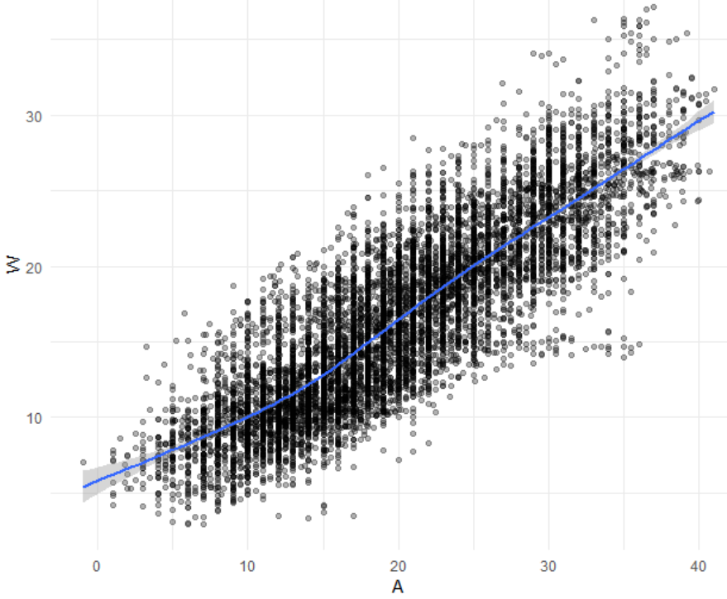
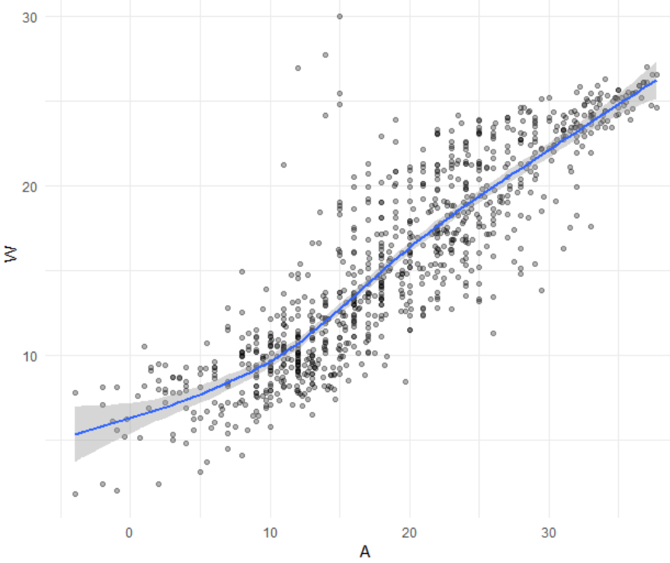
Part 1: Examining the Relationship
Run Chunk 4
Train Plot
Test Plot

Slide 12
Part 2: Linear Model
Linear Model
Simplest Relationship that is Easily Explained
For every 1 Degree Change in A, W changes by b Degrees
When A=0 Degrees, the Expected Water Temperature is a Degrees
$$W=a+bA+ ε$$

Slide 13
Part 2: Linear Model
Run Chunk 1
Fits Linear Model to Train Data
What is Your Intercept?
What is Your Slope?
Run Chunk 2
Saves Predictions to Train/Test
Run Chunk 3
Saves Residuals to Train/Test
add_predictions(MODEL,var=“NAME”)
add_residuals(MODEL,var=“NAME”)

Slide 14
Part 3: Polynomial Model
Polynomial Model
“Feature Engineering”
Generalized Additive Model
Geom_smooth() Fits a GAM when Fitting a Curve
Useful for Approximating Nonlinear Relationships
Dependent on Degree “k”
Goal: Choose Best “k”
$$W=a+b_{1}A+b_{2}A^{2}+…+b_{k}A^{k}+ ε$$

Slide 15
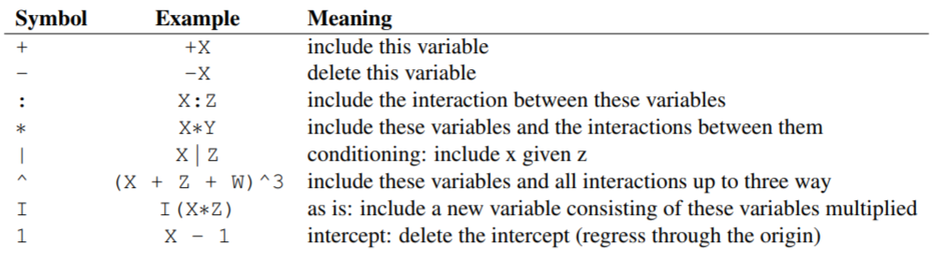
Part 3: Polynomial Model
Formula Object in R
Special Notation
Helpful Table:
We will Use the I() Function to Create New Variables Based Off Variables We Have

Slide 16
Part 3: Polynomial Model
Run Chunk 1
Fits 1st Degree Polynomial
Fits 2nd Degree Polynomial
Fits 3rd Degree Polynomial
Fits 4th Degree Polynomial
Run Chunk 2
Obtains Predictions Under the Different Polynomial Models

Slide 17
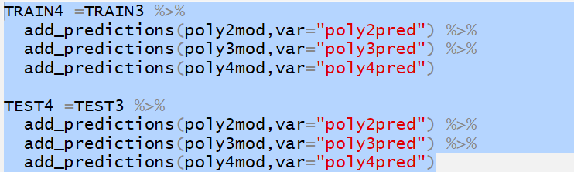

Part 3: Polynomial Model
Chunk 3
Code Needs Modification
Highlight Code
TRAIN3 -> TRAIN4 and etc.
Use Ctrl+F (Find and Replace)
‘predictions’ -> ‘residuals’
‘pred”’ -> ‘res”’
Run Chunk 3 After Modifying

Slide 18
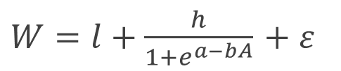
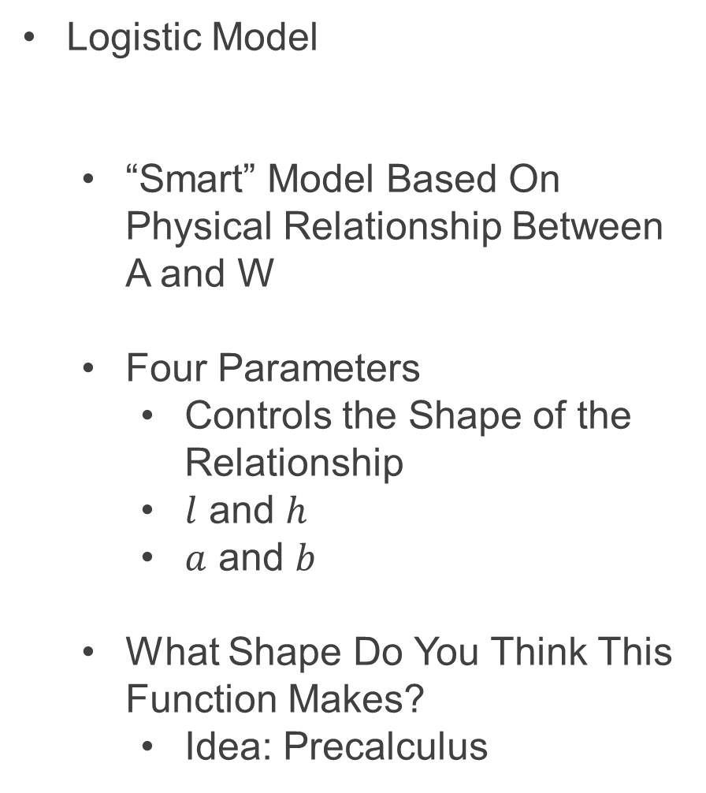
Part 4: Logistic Model
Logistic Model
“Smart” Model Based On Physical Relationship Between A and W
Four Parameters
Controls the Shape of the Relationship
$l$ and $h$
$a$ and $b$
What Shape Do You Think This Function Makes?
Idea: Precalculus
$W=l+\frac{h}{1+e^{a−bA}}$ $+ ε$

Slide 19
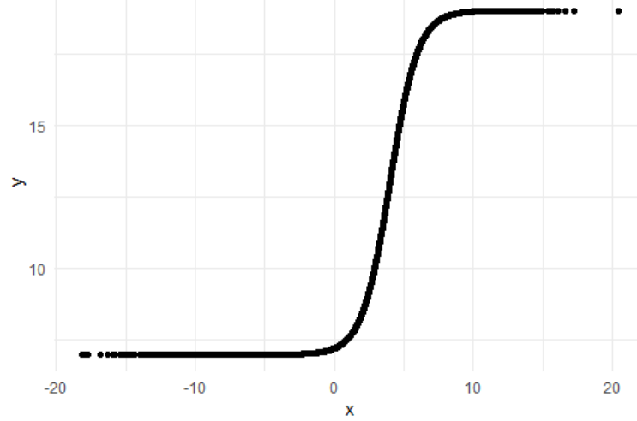
Part 4: Logistic Model
Run Chunk 1
Plant that Seed
Example Model
Parameter Investigation
What Does 7 Represent?
What Does 12 Represent?
What Does 4 Represent?
What Does 1 Represent?

Slide 20
Part 4: Logistic Model
Run Chunk 2
Creation of Modeling Function
Creation of MSE Function Specific to this Model
Run Chunk 3
Use optim() Function With Smart Starting Values Based on Understanding of The Model
Finds Estimates Based on Minimization of MSE

Slide 21
Part 4: Logistic Model
Run Chunk 4
Use Logistic Model Function and Estimated Parameters from optim() to Obtain
Predictions
Residuals

Slide 22
Intermission
Run Code Chunk
save.image() = Used to Save Workspace into .Rdata File
load() = Used to Load Workspace from .Rdata File
.Rdata = File Extension of R Workspace File (All Objects in Global Environment)

Slide 23
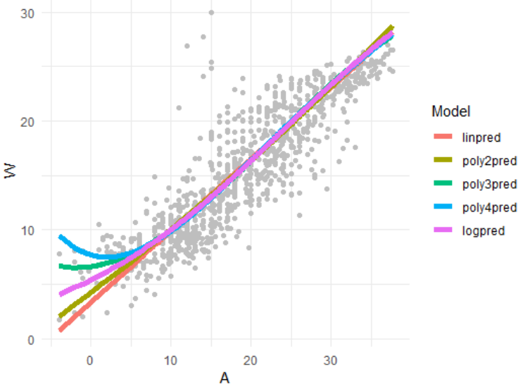
Part 5: Evaluation by Visualization
Run Chunk 1
Plots of Different Models
What Can We Say About the Different Models?
Which Model Would You Use?

Slide 24
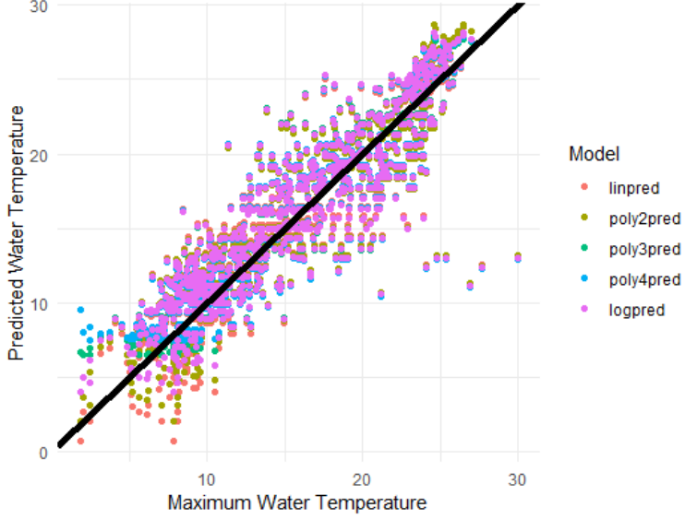
Part 5: Evaluation by Visualization
Run Chunk 2
Comparing Predictions vs Actual Maximum Water Temperatures
Models Give Similar Predictions

Slide 25
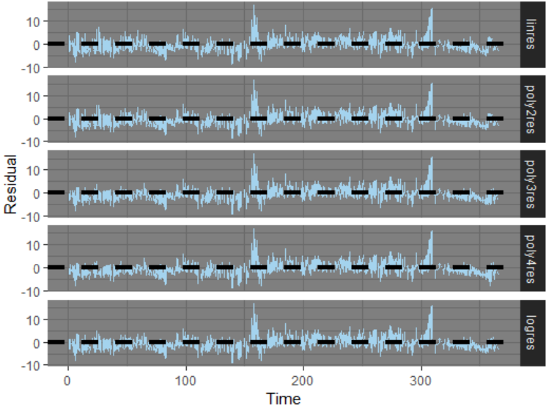
Part 5: Evaluation by Visualization
Run Chunk 3
Shows Residuals Under the 4 Models Plotted Over Time
What is the Problem?

Slide 26
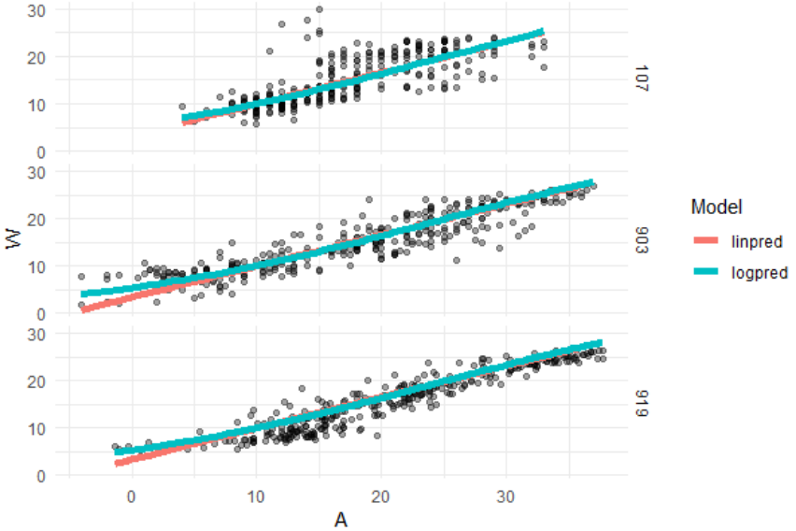
Part 5: Evaluation by Visualization
Run Chunk 4
Evaluate Models For the Three Locations Separately

Slide 27
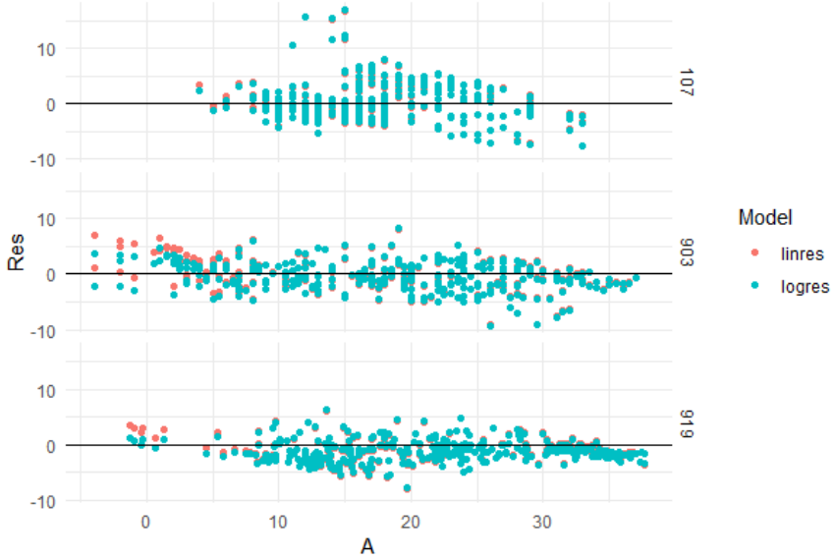
Part 5: Evaluation by Visualization
Run Chunk 5
Evaluate Error For the Three Locations Separately (by A)

Slide 28
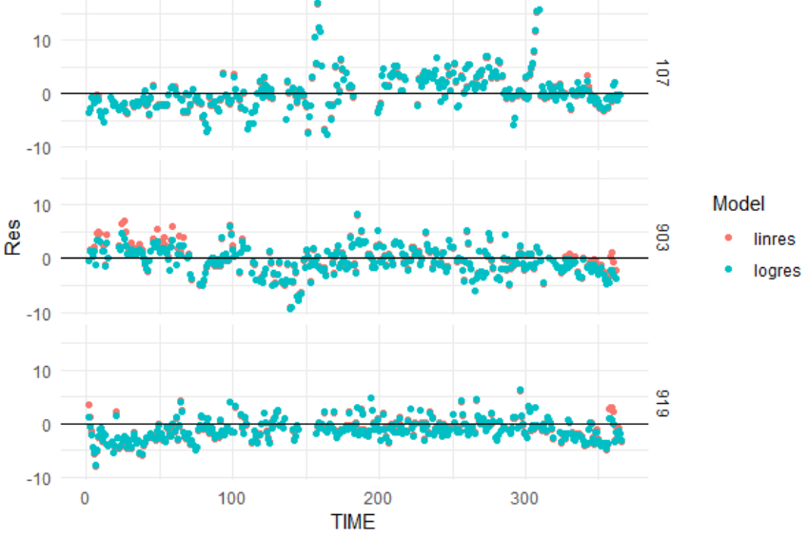
Part 5: Evaluation by Visualization
Run Chunk 6
Evaluate Error For the Three Locations Separately (by Time)

Slide 29
Discussion
Problems With The Approach
Same Model For All Locations
Not All Locations Used in Train
Not All Locations Used in Test
Residuals Indicate that Model Can Be Improved
All Models Have the Same Issue if Used for Predicting the Maximum Water Temperature Given the Maximum Air Temperature

Slide 30
Closing
Disperse and Make Reasonable Decisions

